Slide 1
Machine Learning with Python
Data Visualization and Classifier Training

Slide 2
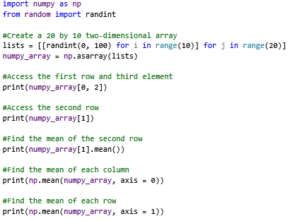
Before We Begin
Numpy makes handling matrices and arrays in Python very easy
Pandas can be considered a “superset” of Numpy, and creates data frames from arrays

Slide 3
Features vs. Dimension
The dimensionality of a data set is often not how many features are in the data set
This is particularly true in biology because many features are correlated, redundant, or do not contribute to the separation of a dataset
Therefore, removing irrelevant features would not only reduce the size of the dataset but often leads to improvements in classification

Slide 4
Features vs. Dimension
What do you think is the dimensionality of this simple dataset?
Features can be combined together to created new features
Other features can be created from the raw data (eg: Chaos Game Representations of nucleic acid sequences)
Sample | 1 | 2 | 3 | 4 | Class
1 | 5 | 2 | 7 | 1 | A
2 | 4 | 5 | 6 | 2 | A
3 | 7 | 1 | 5 | 0 | A
4 | 3 | 6 | 8 | 3 | A
5 | 8 | 3 | 5 | 1 | A
6 | 1 | 4 | 3 | 1 | B
7 | 3 | 1 | 2 | 0 | B
8 | 2 | 5 | 3 | 2 | B
9 | 1 | 2 | 4 | 3 | B

Slide 5
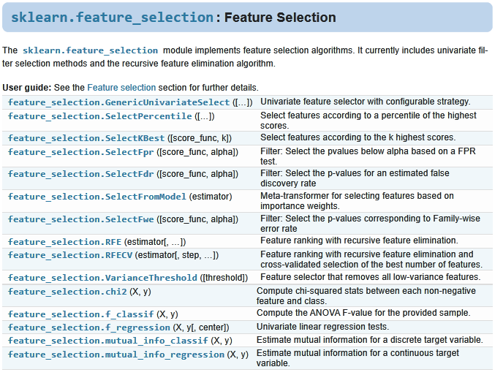
Features vs. Dimension

Slide 6
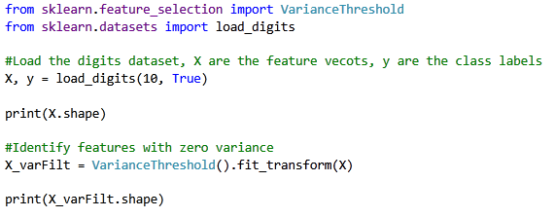
Features vs. Dimension

Slide 7
Visualizing Data
Visualizations tell a story
Often relies on dimensionality reduction algorithms
Attempts to efficiently project data into a lower dimensional space
Eg: In transcriptomic studies you could have tens of thousands of features, but only a small fraction could be responsible for driving the differences between two treatment group

Slide 8
Visualizing Data
Generally all Scikit-Learn projection algorithms have the following form:
ALGORITHM(<PARAMETERS>).fit(X)
ALGORITHM(<PARAMETERS>).fit_transform(X)
Two main approaches
Matrix Factorization (PCA, NMF, SVD etc)
Good for transforming new data into the projected space
Graph Based Methods (t-SNE, UMAP, etc)
Generally cannot transform new data into the projected space

Slide 9
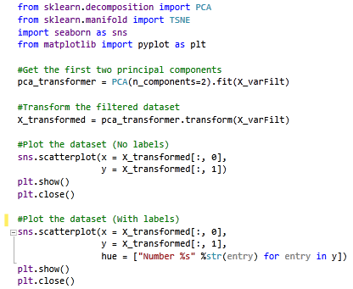
Visualizing Data

Slide 10
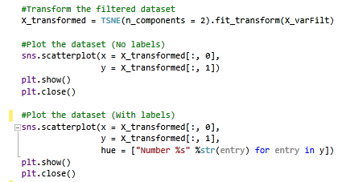
Visualizing Data

Slide 11
Visualizing Data
Lots of graph-based methods require a distance or similarity matrix as input
UMAP tends to outperform t-SNE (see: “Dimensionality reduction for visualizing single-cell data using UMAP.”)
UMAP can be combined with other methods such as Random Forest Proximity Matrices (see: “Cluster ensemble based on Random Forests for genetic data”)

Slide 12
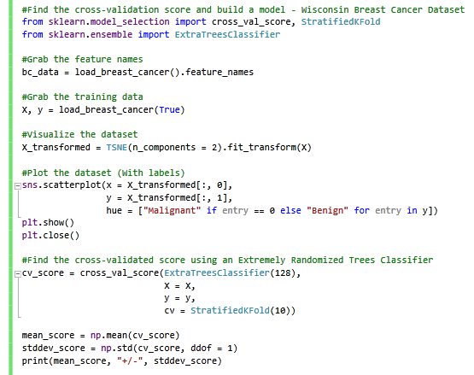
Cross-Validation
Good for estimating how well a classifier performs
Good for finding good hyper-parameter settings (Grid Search or Randomized Grid Search)

Slide 13
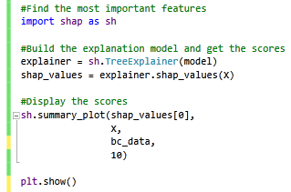

Training a Classifier and Finding Important Features

Slide 14
Workshop
Attempt the following steps using other toy datasets from Scikit-Learn (https://scikit-learn.org/stable/datasets/index.html):
1) Feature Selection (Using SelectKBest)
2) Visualization (Using any method)
3) Cross-Validation and Model Training (Using any Method)
4) Finding the Best Features Using ‘shap’ (Although you can use any classification model – it can take a considerable amount of time to identify features so stick with either a Random Forest or Extremely Randomized Trees)

